Slide 1
Problem Statement
Machine learning driven device circuit co optimization

Slide 2
Objective:-
Predict and optimize the inverter design {width(W), length(L), number of sheets(N)} to meet specified power and delay requirements for advanced nanosheet FET and CFET-based technologies
Solution Approach :-
Developing an analytical model for inverter delay and power as functions of key parameters such as effective current and capacitance.
Why develop an analytical model :-
Analytical models provide quick, intuitive insights into how performance metrics (like delay and power) vary with design parameters, without the computational burden of full simulations.
It helps in early stage exploration, While analytical models are fast, they rely on assumptions. Validating them through TCAD simulations ensures that the models are physically grounded and accurate under real-world operating conditions.
If from an analytical model , we know what are the current and capacitance ranges to look for , we can proceed accordingly

Slide 3
2. Build a Deep Neural Network (DNN)-based forward model to predict current and capacitance values for inverter design parameters (W, L, N). Implementing optimization algorithms like Bayesian or grid search .
Analytical Model Formulation for delay and power
Validating it using mixed mode simulations (formulating analytical model helps to reduce this)
From the data obtained from TCAD ; develop a DNN based forward model which gets trained on this data
The output of this feed forward model can give us the parameters that we can feed into TCAD to have an optimised design for inverter
Use optimization algorithms like Bayesian optimization or grid search

Slide 4
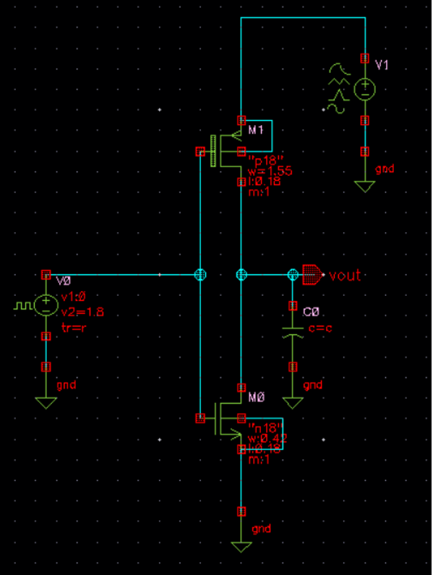
To start formulating the analytical model , inverter was simulated in cadence simulation software by taking different load capacitances.
Following Parameters were used for inverter design
Gate Length(Same for both PMOS and NMOS) : 180nm
Gate Width(PMOS) : 1550nm
Gate Width(NMOS): 420nm
Why unsymmetric widths?
Mobility Difference : electron mobility in NMOS is significantly higher than hole mobility in PMOS , for same gate dimension , NMOS would conduct more than PMOS
To balance this PMOS transistor should be wider
Clean switching , symmetric voltage – transfer characteristics ; leads to better noise margins

Slide 5
Well known formula to calculate delay is
τ_{P} = C_{L} V_{DD} / I _{Effective}
The parasitic capacitance value from cadence : C_{d,gNMOS} + C_{d,b,NMOS} + C_{d,gPMOS} + C_{d,b,PMOS} = 4fF
so the C_{Load} is varied from 100fF to 4500 fF ; in order to ignore the parasitic capacitances
Well known delay calculations are one point, two point and 3 point models
One Point Model:-
τ_{PHL} = C_{L} V_{DD} / 2I_{ON(NMOS)}
τ_{PLH} = C_{L} V_{DD} / 2I_{ON(PMOS)}
τ_{P} = (τ_{PLH} + τ_{PHL})/2
Two Point Model:-
I_{effective(NMOS)} =( I_{NL} + I_{NH} )/2
I_{effective(PMOS)} =( I_{PL} + I_{PH} )/2
τ_{PHL} = C_{L} V_{DD} / 2I_{effective(NMOS)}
τ_{PLH} = C_{L} V_{DD} / 2I_{effective(PMOS)}
τ_{P} = (τ_{PLH} + τ_{PHL})/2
Three Point Model:-
I_{effective(NMOS)} =( I_{NL} + I_{NH} + I_{NM} )/3
I_{effective(PMOS)} =( I_{PL} + I_{PH} + I_{PM} )/3
τ_{PHL} = C_{L} V_{DD} / 2I_{effective(NMOS)}
τ_{PLH} = C_{L} V_{DD} / 2I_{effective(PMOS)}
τ_{P} = (τ_{PLH} + τ_{PHL})/2

Slide 6
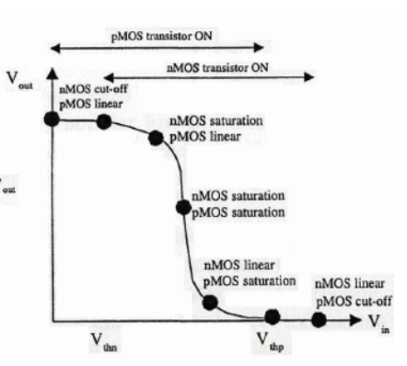
V_{DD} = 1.8V
Vth_{PMOS} = -502 mV
Vth_{NMOS} = 468mV
I_{ON} (PMOS) = 374.543 μA
I_{ON} (NMOS) = 243.61 μA
I_{dnmos} (V_{GS} = 0.5 V_{DD} , V_{DS} = V_{DD} ) = I_{NL} = 48.271 μA
I_{dpmos} (V_{GS} = 0.5 V_{DD} , V_{DS} = V_{DD} ) = I_{PL} = 78.67 μA
I_{dnmos} (V_{GS} = V_{DD} , V_{DS} = 0.5V_{DD} ) = I_{NH} = 233.78 μA
I_{dpmos} (V_{GS} = V_{DD} , V_{DS} = 0.5V_{DD} ) = I_{PH} = 327.25 μA
I_{dnmos} (V_{GS} = 0.75 V_{DD} , V_{DS} = 0.75V_{DD} ) = I_{NM} = 138.112 μA
I_{dpmos} (V_{GS} = 0.75 V_{DD} , V_{DS} = 0.75V_{DD} ) = I_{PM} = 201.743 μA
From these calculations delay from simulations were tabulated and errors were calculated with respect to simulation delay for different load capacitances

Slide 7
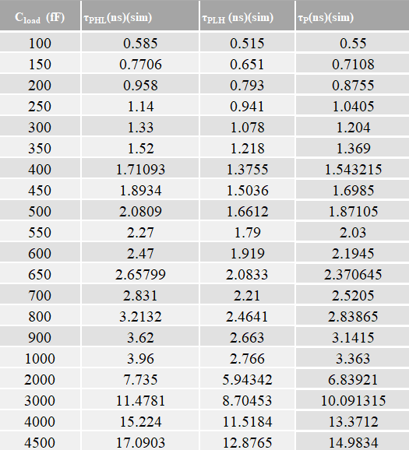
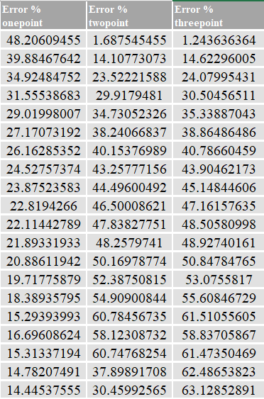

Slide 8
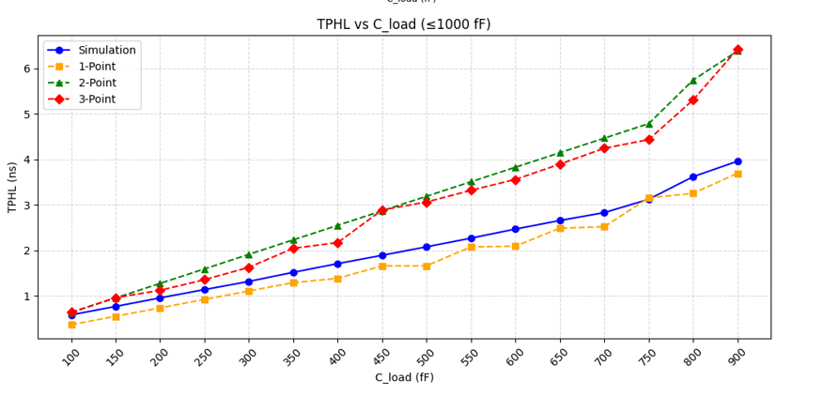
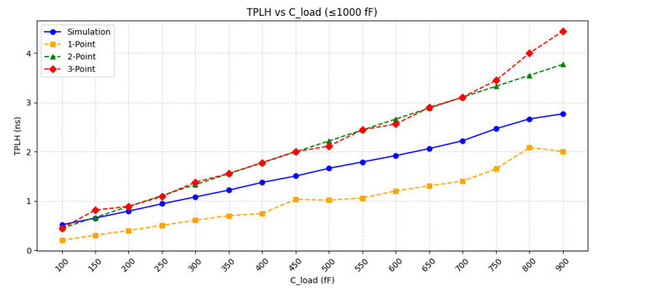
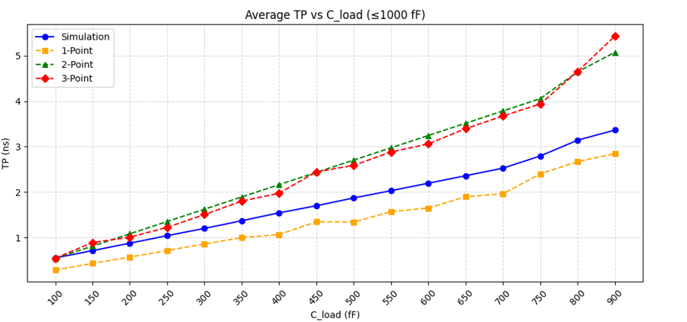

Slide 9
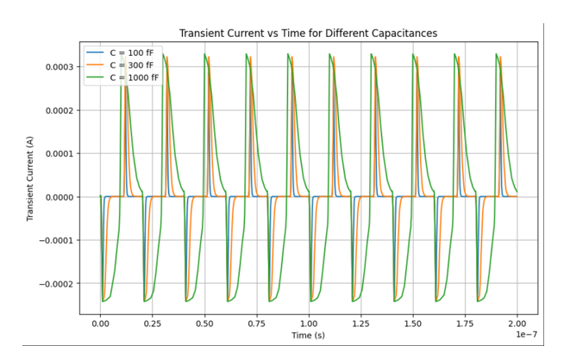
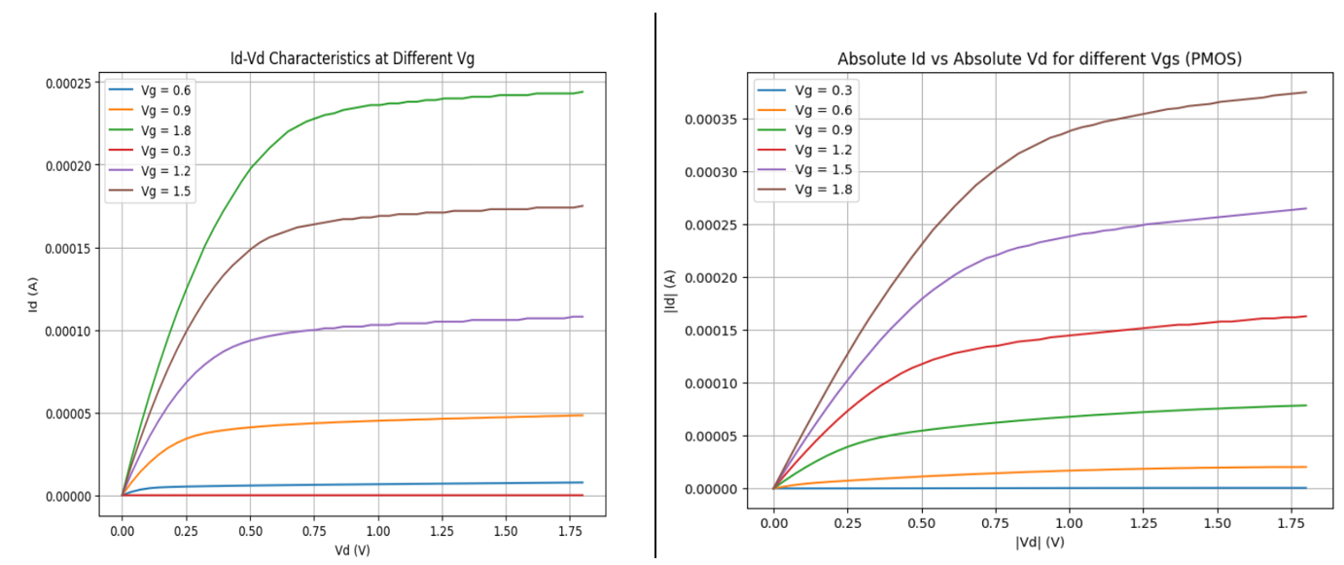

Slide 10
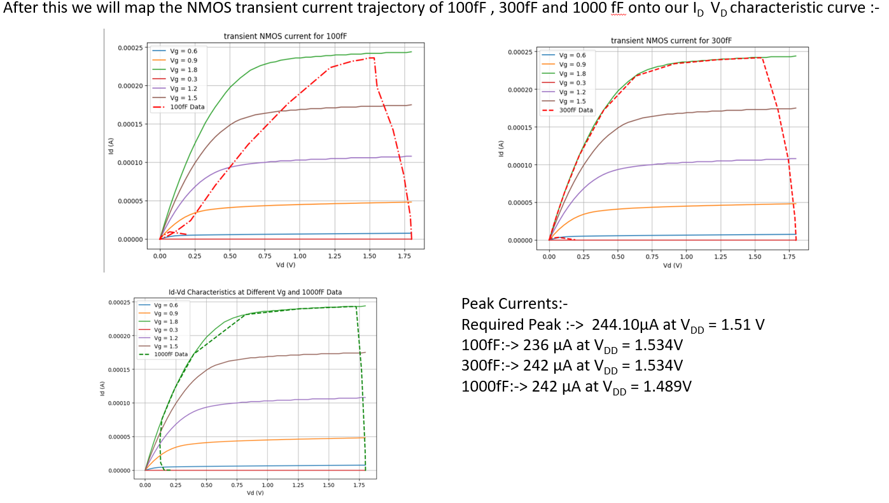

Slide 11
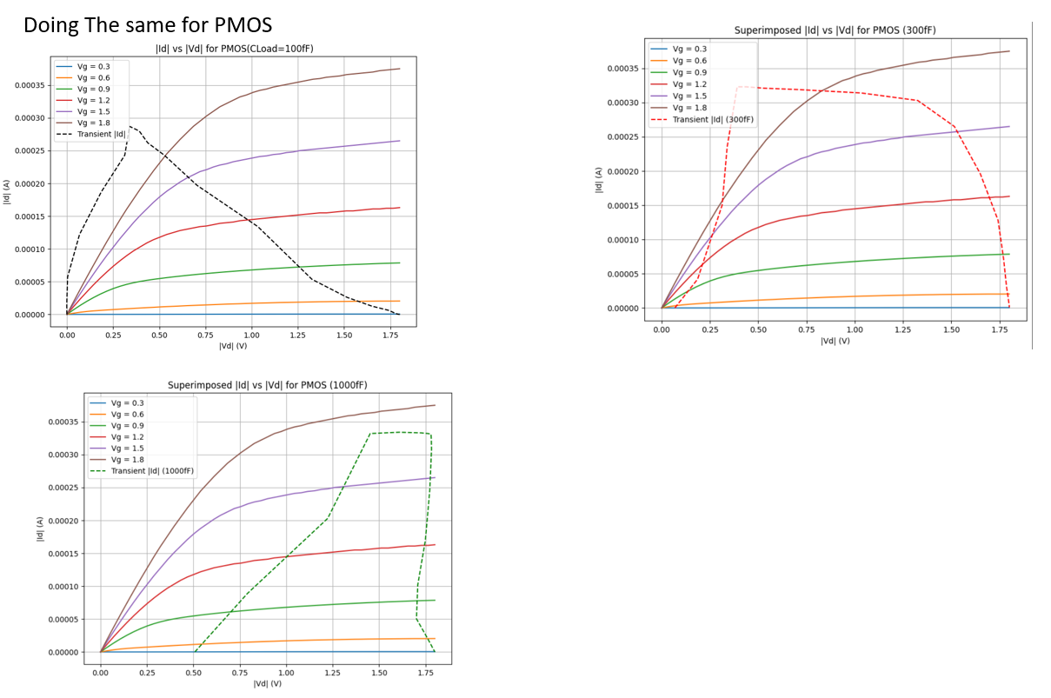

Slide 12
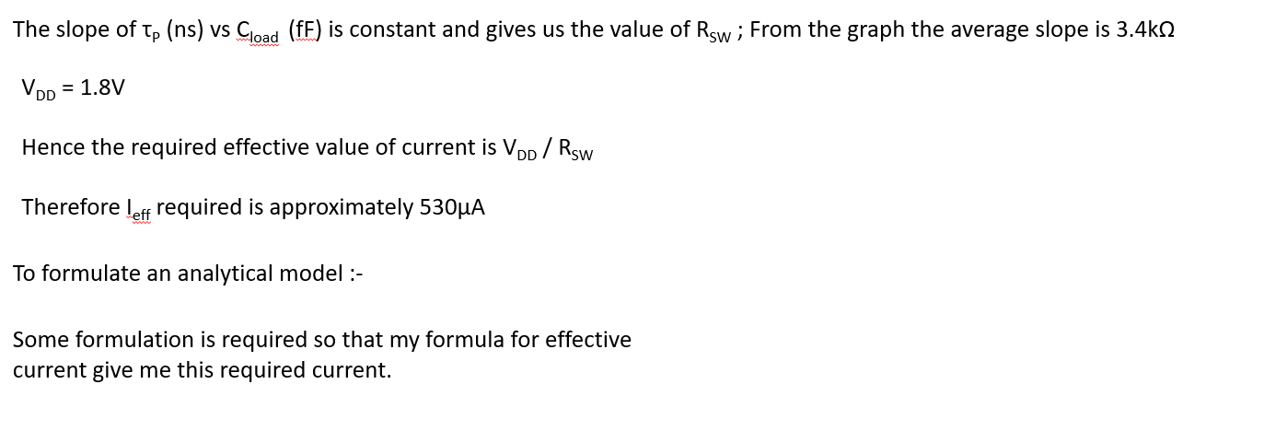
My Approach :-
τ_{PHL} is different for different capacitances so what if we calculate effective current required from simulation delay results for each and every capacitance and average It and look at what points this current come in NMOS similarly we can do for PMOS and we can formulate an analytical model

Slide 13
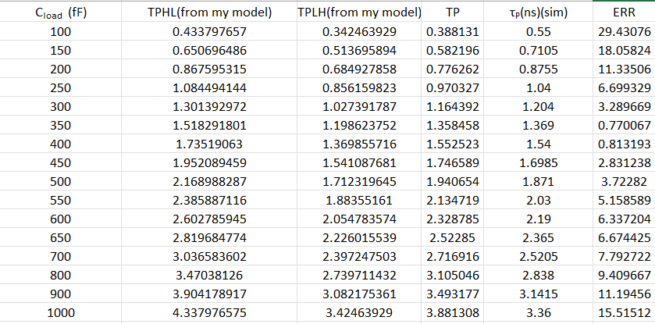
For NMOS – > average current is 207.4 μA coming at I_{DS} (V_{GS} = V_{DD} , V_{DS} = 0.3V_{DD})
For PMOS -> average current is 262.8014 μA coming at I_{DS} (V_{GS} = 5V_{DD} /6 and V_{DS}= V_{DD})

Slide 14
CFET Data:-
L_{G} =12nm
W = 20nm
H = 5nm
V_{DD} = 0.7v
I_{ON} NMOS = 10.08 μA
I_{ON} PMOS = 7.05 μA
I_{L,NMOS} = 6.76e-9 A
I_{L,PMOS} = 8.24e-9 A
I_{H,NMOS} = 9.17e-6 A
I_{H,PMOS} = 6.2e-6 A

Slide 15
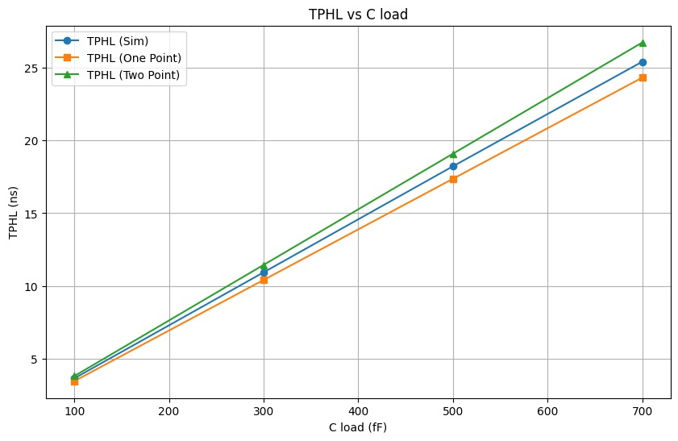
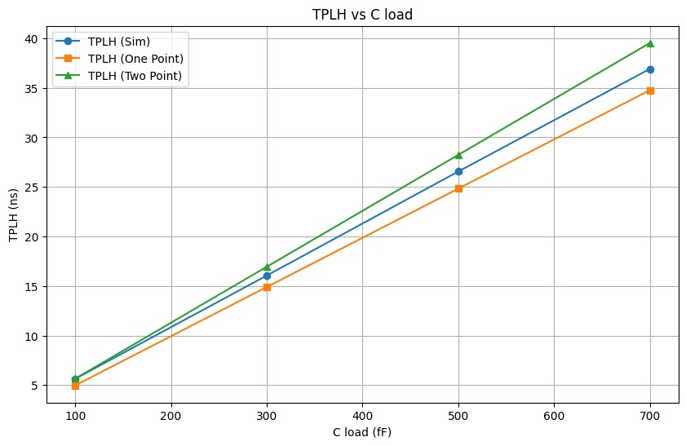
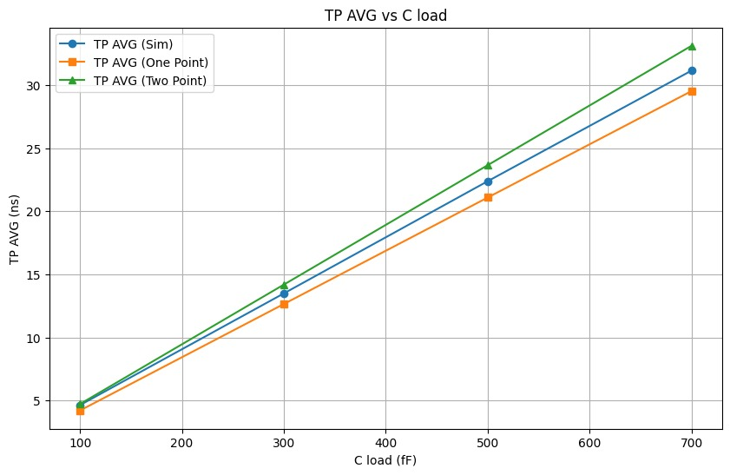

Slide 16
